Slide 1
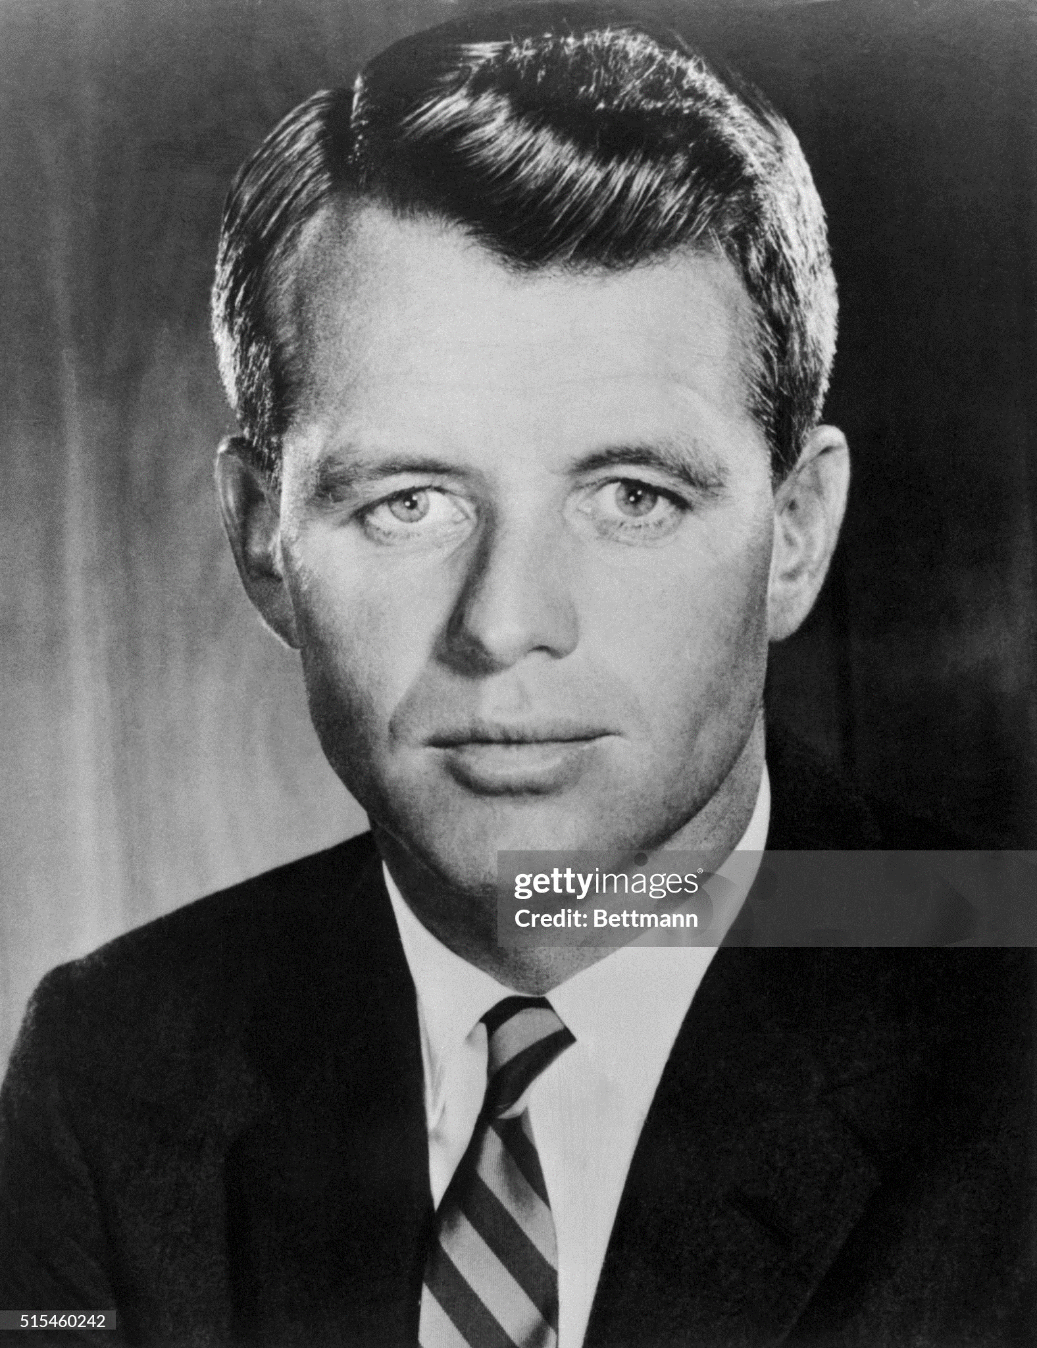
Robert (Bobby) Kennedy (1925-1968)
Healthy younger brother
…Harvard
…devout Catholic
…training during war
Completes law school
….journalist
…..counsel to Justice Dept. 1952
Devout Catholic..11 children
…(probably) loyal to wife
Joe Snr…Bobby to work
For McCarthy..anti communist
…objects to methods
….fist fight Roy Cohen?
Resigns….dedicates life to
Success of John
Combative, shouting, detail
….loyal…workaholic. Tenacious

Slide 2
Running for Senate 1953
Incumbent Republican
Senator Henry Cabot Lodge jr.
…war hero, wealthy, popular
Joe Snr funds campaign
Pays Newspaper $500K to switch
War hero, writer, anti communist
Bobby Kennedy: delivers aggressive campaign…family travels across state
Wins narrow victory 51% vs 48%

Slide 3
Kennedy the Senator (1953-1960)
First year in hospital…..given “last rites”…Writes book “Profiles in Courage
Delivers incentive/environment protection package for Massachusetts
Wins re-election 1958 with 72% of vote
Opposes McCarthy…but does not vote on Censure Vote
Rejects first draft Civil Rights Reform…approves “jury amendment
Committee Foreign Affairs….claims “missile gap”
Joins committee investigation organised crime…Bobby as chief counsel

Slide 4
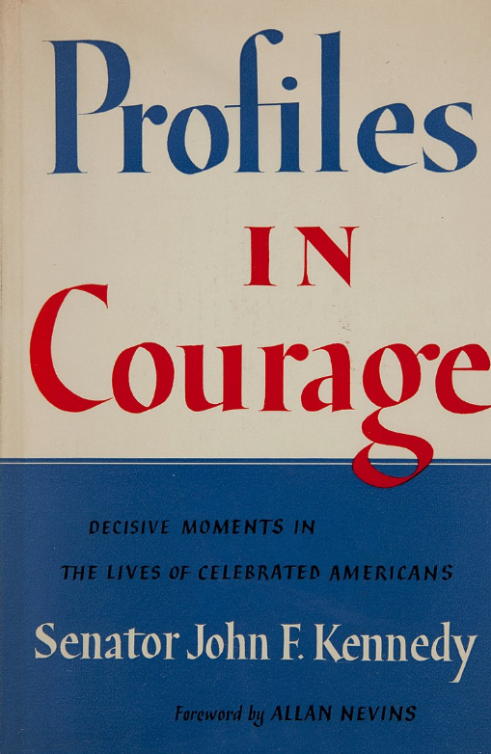
Profiles in Courage
Released from hospital
….”ghost written”?
Lives of 8 Senators
all opposed popular view
Another Best Seller

Slide 5
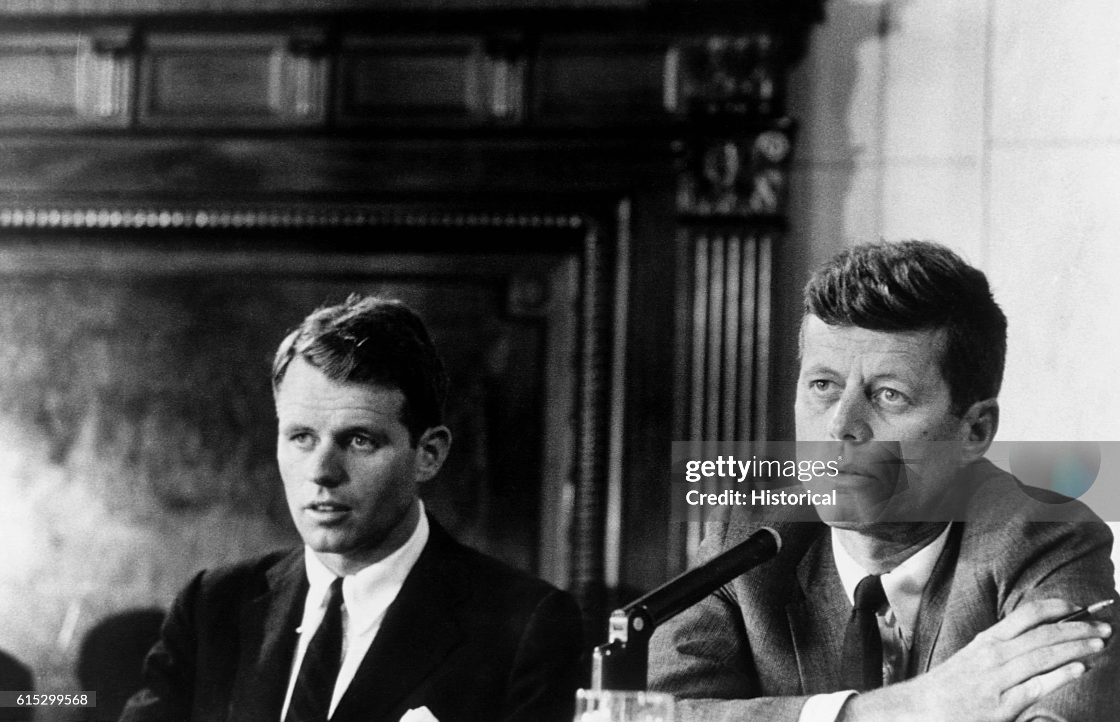
John and Bobby…McLellan Committee

Slide 6
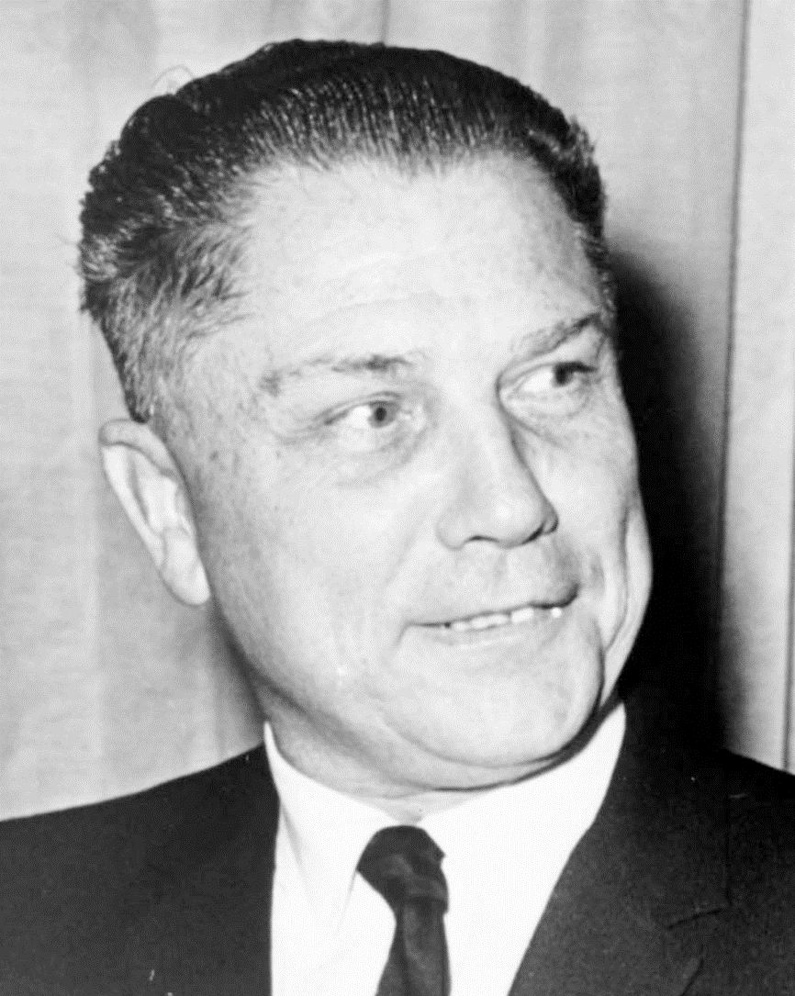
Teamsters Union vs Kennedy's
Rapidly expanding union
….trucking replace railroads
2.3 members by 1960’s
Jimmy Hoffa (1913-1975?)
Union & organised crime
….funds from Prohibition
…extortion, bribery, violence
…”quicky strikes". Boycotts
Hoffa takes of Presidency 1957
JFK on anti Racketeering
..McLellan Committee
…Bobby counsel
..high publicity…JFK/Bobby famous
Hoffa accused of bribery
…acquitted
…Bobby fight continues through 60’s
…eventually successful
Hoffa in jail 60’s….murdered 1975

Slide 7
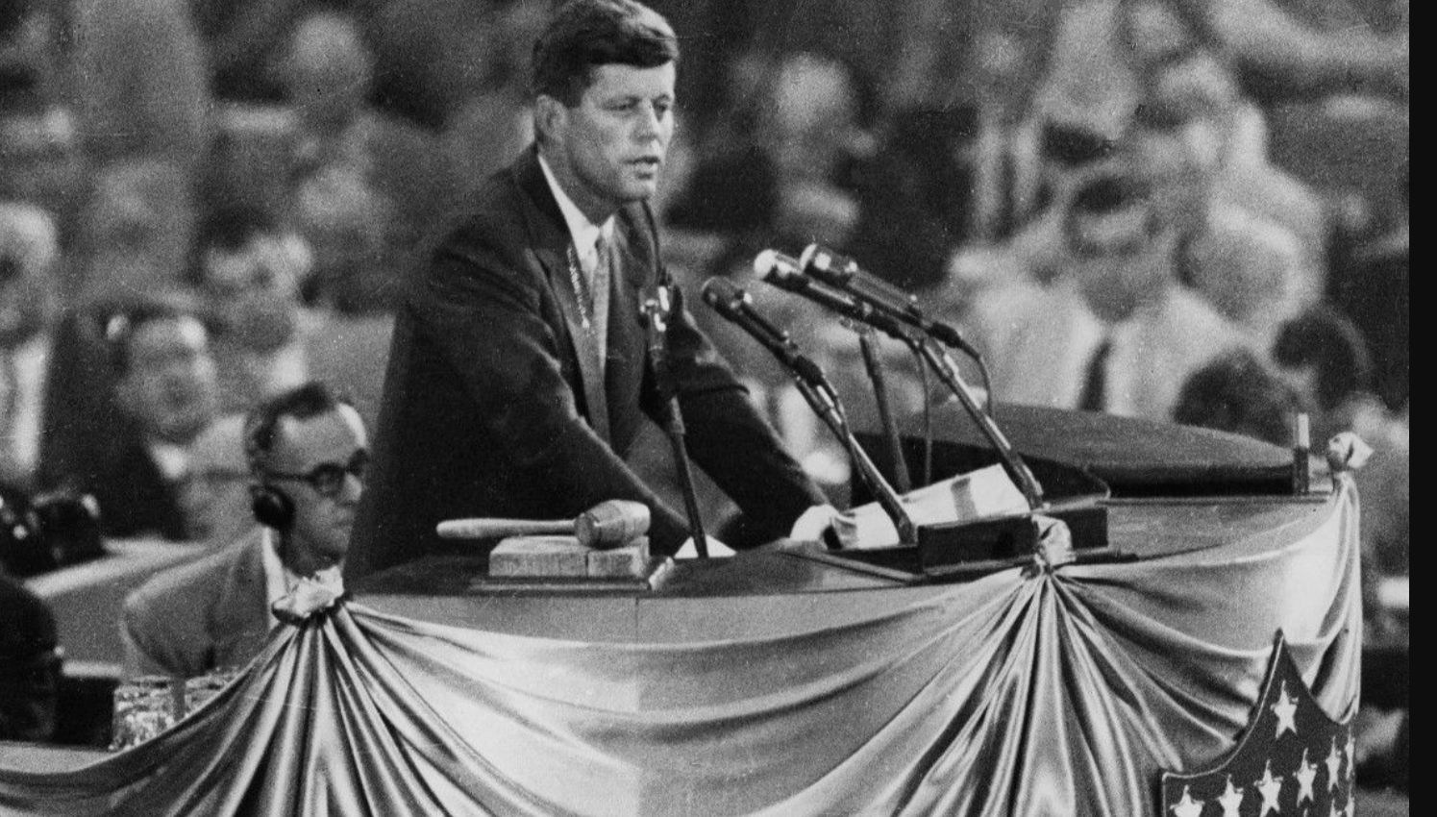
The rising star: JFK at 1956 Convention …after losing bid to run as Vice President

Slide 8
Presidential Election 1960

Slide 9
Intermission

Slide 10
Presidential Election 1960

Slide 11
Selecting candidates
Democrat Campaign organisation: youth and leadership
Joe Snr finances campaign….Kennedy able to run “independently”
Bobby…campaign manager
Family mobilized: I feel like a family stores running against a chain store”
Convention and Vice President
Wins on first ballot/ Selects Lyndon Johnson …Texas Leader of the Senate as VP
Wants to retain White Southern votes
LBJ …mutual dislike, crude, aggressive….liberal views….obscured
Opponent…Republican….Richard Nixon….Vice President 8 years. Unopposed
The main election issue: ….”Missile Gap”

Slide 12
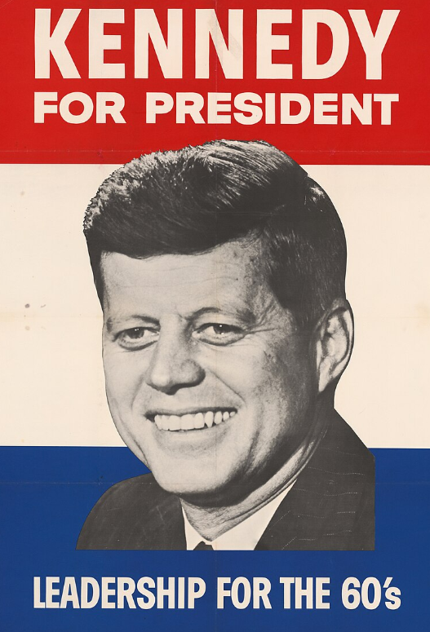
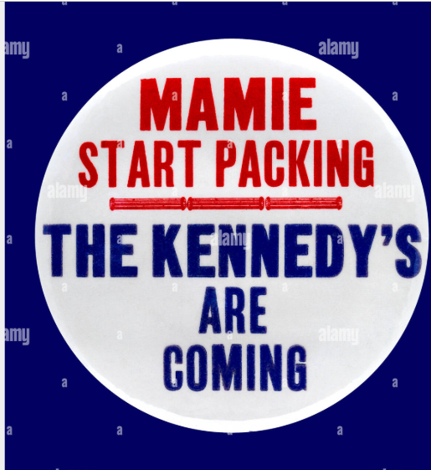
Kennedy Campaign….Eisenhower “asleep at wheel”…USSR ahead in missiles

Slide 13
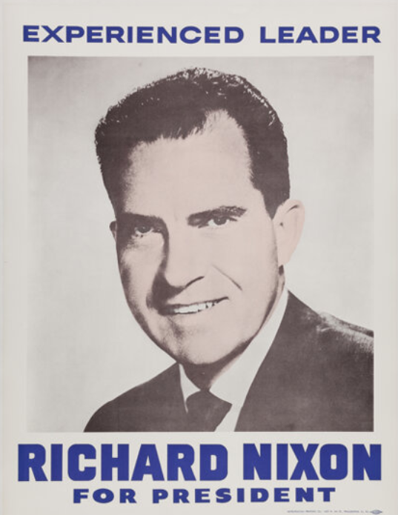
Nixon: formidable opponent …anti communist, denies “gap” exists ….Eisenhower…popular, trusted…endorses Nixon (eventually) (…reality……US 18,000 warheads vs 1,600 USSR !)

Slide 14
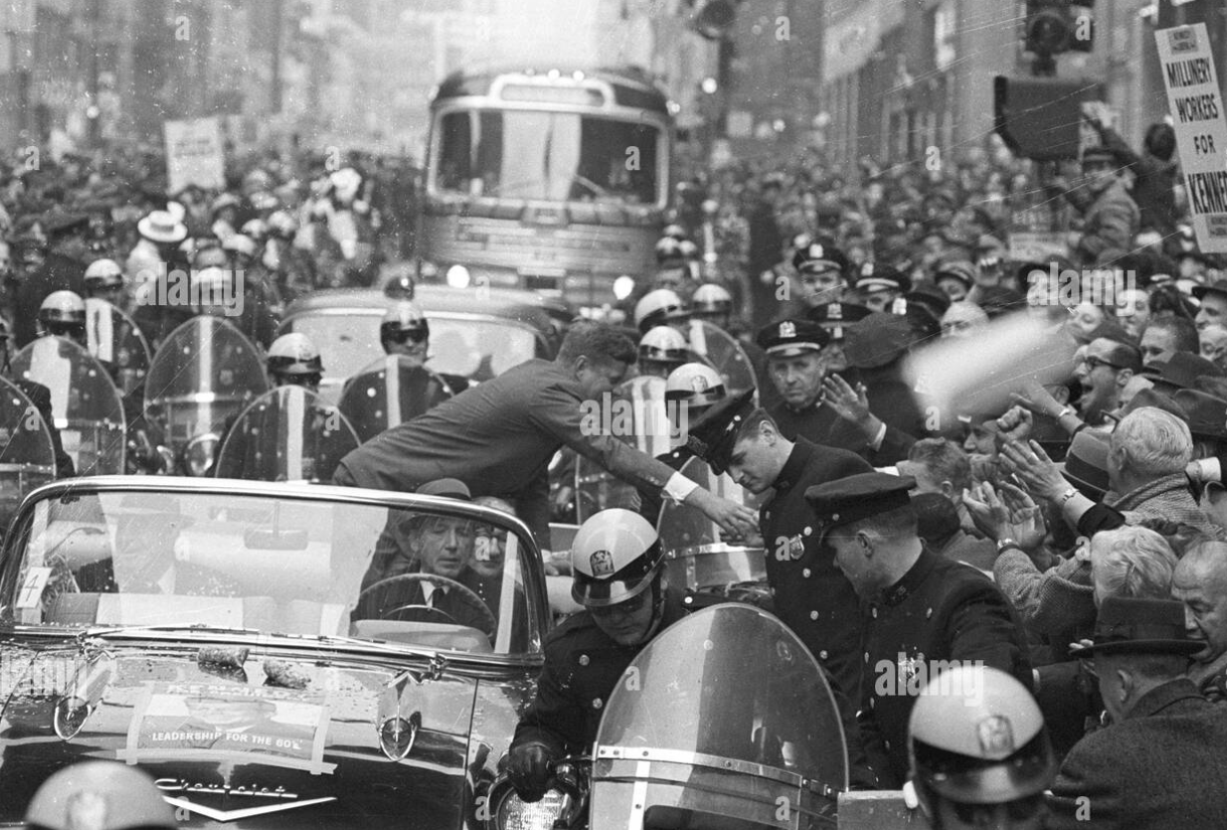
Kennedy crowds…enthusiasm

Slide 15
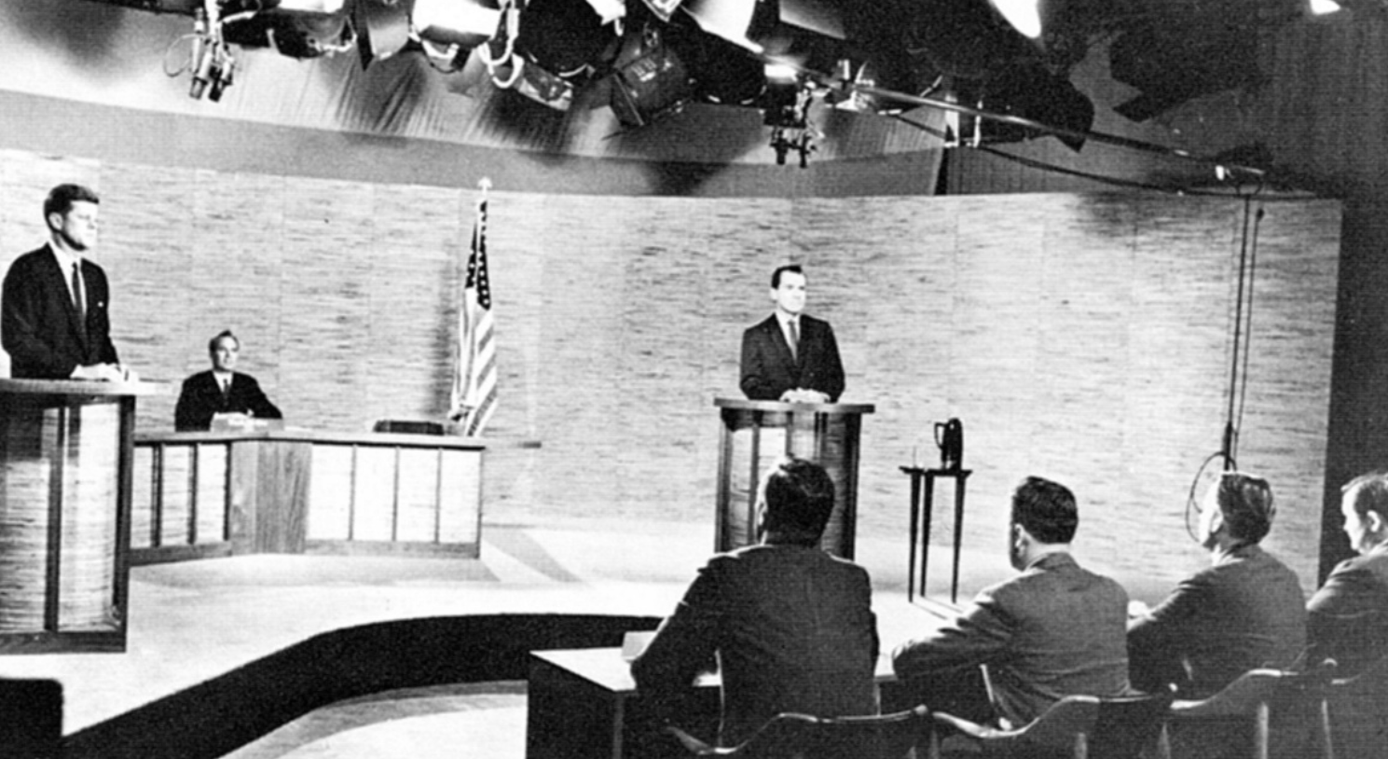
First televised debates JFK..young, medicated, faces camera Nixon…tired, deliberate…faces Kennedy

Slide 16
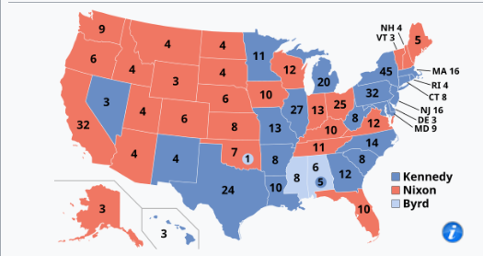
1960 Election
Closest election recorded
JFK 49.7% vs Nixon 49.2%
..but elector college
JFK 303, Nixon 219
“America First Party”
..white segregationist
…South…”Solid South” breach
Democrats control Congress
Polling irregularities “undead”
…Texas (Johnson)
…Chicago (Major Daley)
…not enough to change?
Eisenhower advised Nixon to
Challenge…declines:”Bad
Example to 3rd world”

Slide 17
The interregnum …Election Nov 4th..Innaugaration Jan 20th
Eisenhower commissions invasion of Cuba
Ex Batista counter revolutionaries authorised to invade…capture/ execute Castro
No US military involvement
Expect “spontaneous uprising
“Farewell Address”
Astonished by “Missile Gap” fake news
““we must guard against the acquisition of unwarranted influence, whether sought or unsought, by the military–industrial complex.”
Meets with Kennedy: advises on “Gap”…..world leaders…economy

Slide 18
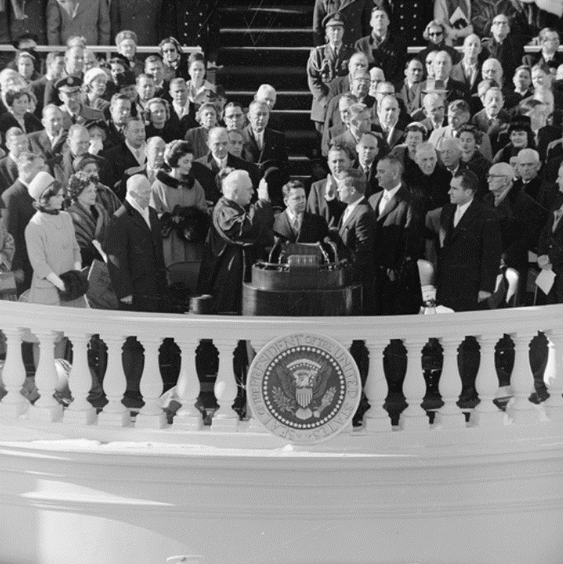
Inauguration
“The torch has been passed to a new
generation of Americans—born in this
century, tempered by war, disciplined
by a hard and bitter peace, proud of
our ancient heritage
—and unwilling to witness or permit the
slow undoing of those human rights to
which this nation has always been
committed, and to which we are
committed today at home and
around the world.^{[39]}
And so, my fellow Americans:
ask not what your country can do for you
—ask what you can do for your country”.^{[39]}
Eisenhower
Jackie
JFK
Nixon

Slide 19
Limits of power 1961-1962

Slide 20
Kennedy first year…
Cold War strategy
Flexible Response vs “Massive Retaliation
Increases military expenditure 50%....despite Eisenhower advice
Foreign Aid and investment to 3rd World….Africa Policy…new nations
Agrees to Cuban “invasion”
Domestic Policy….treats as distraction
Appoints Bobby Attorney General….continue investigations of Unions
Introduces “Affirmative Action” …to ensure equal opportunity government jobs
Avoids Civil Rights ….job of Bobby “Keep the President out of this Civil Rights Mess”
Provides Federal troops to protect “Freedom Riders”….transport discrimination
Priority Foreign Relations….off to Vienna to meet Khrushchev to reduce testing

Slide 21
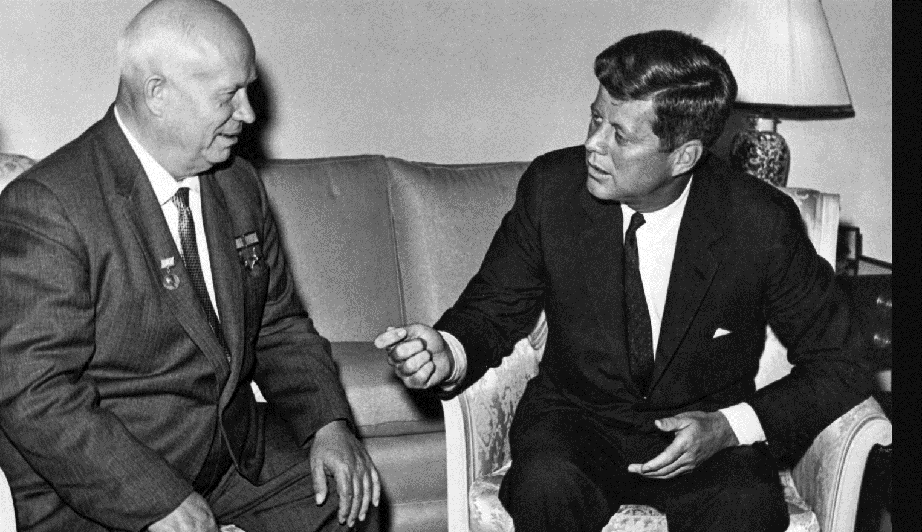
Berlin Crisis 1961
3m Germans leave East (GDR) To West 1945-1961
Kennedy with Khrushchev …Vienna Summit
GDR set to “disappear”
Khrushchev…want Berlin
Under GDR control, close
Border…US to leave Berlin
US believes USSR to attack
…threats exchanged
Khrushchev considers JFK
.”a boy out of his depth”

Slide 22
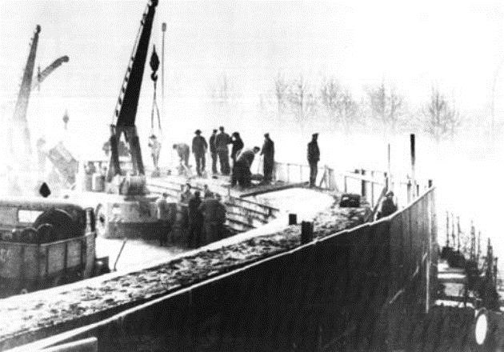
Construction of Berlin Wall
Khrushchev decides to
Seal off West Berlin
….wall built across/ around city
Stand off in Berlin
…tank to tank
Escapees shot
…”world outrage”
Kennedy “ a wall is a hell of
A lot better than a war !”
Meanwhile…in Cuba
US “invasion” goes ahead

Slide 23
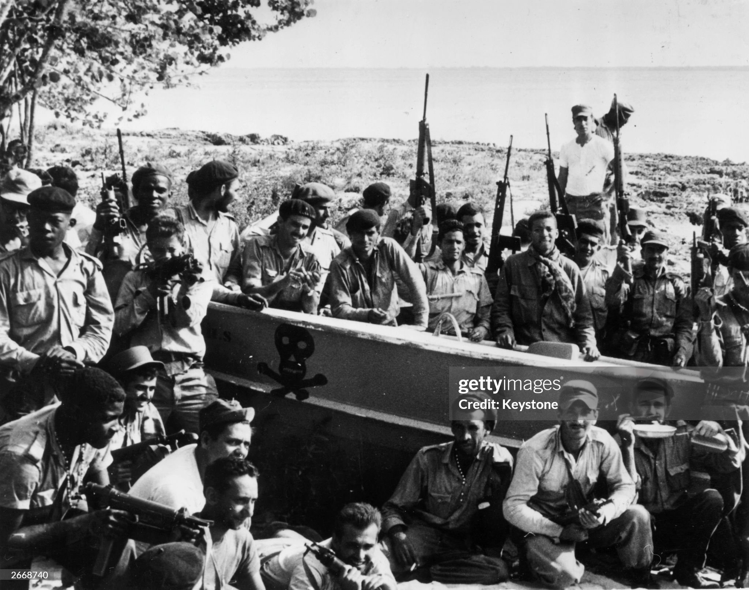
“Bay of Pigs” April 1961
Counter revolutionaries ready to go
Eisenhower administration determine Castro to be eliminated…JFK agree
US (CIA) fund army of ex Batista regime, train Guatemala. Expect national uprising
US reject “direct involvement”
……no troops/planes/ships
….importance of spontaneous revolt
“army of 1,400 land on Cuban coast

Slide 24
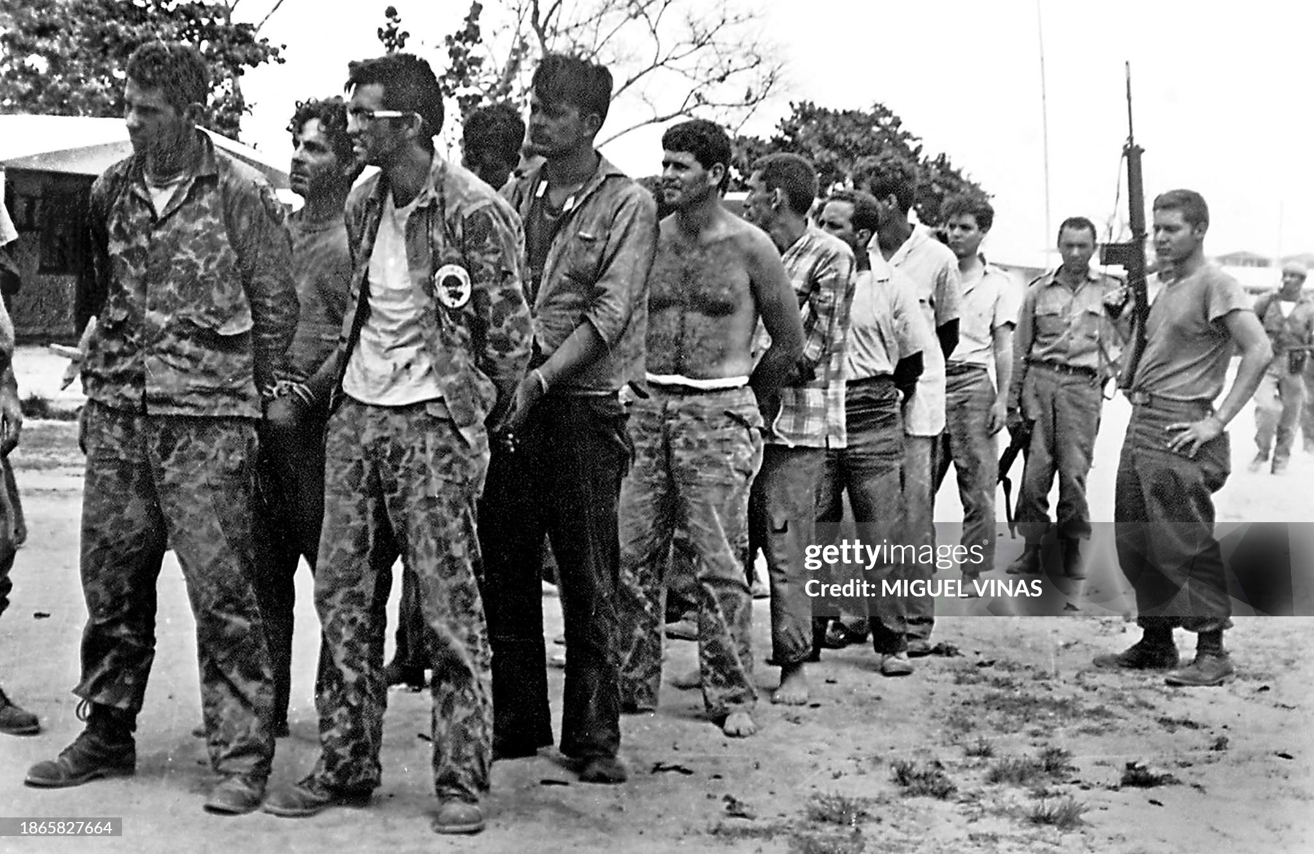
Debacle ….No uprising, Cuban army of 25,000 attack …300 rebels killed, rest captured 100’s shot, rest ransomed…for tractors ,

Slide 25
Bay of Pigs impact
In USA
Kennedy accepts responsibility…humiliated
Establishes Alliance for Progress to provide $ to pro US S American governments…encourage “land reform”…$ taken, reforms not
Increase surveillance Cuba
In USSR/ Cuba
Destroys credibility of anti Castro forces…Castro “super hero”
Convinces USSR & Cuba US invasion imminent
Khrushchev: Cuba about to be invaded and must be saved
……and chance to balance Deploy ICBM missiles in Cuba
…..USSR 4 missiles can reach USA….USA 1000’s deployed Europe
There will be trouble

